Slide 1

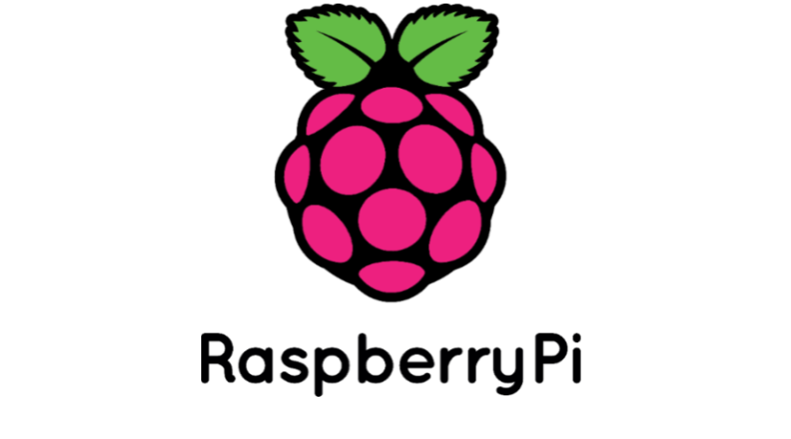
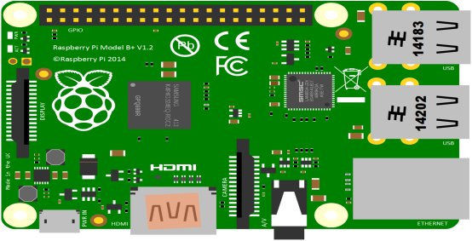



Date: 19th May, 2017

Slide 2
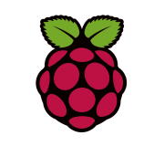


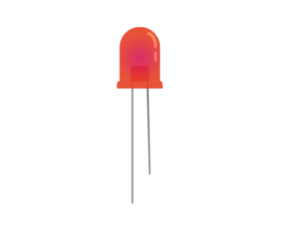

Objective:
What and Why - Raspberry PI(SBC)?
OS Concept.
Java Script , are you serious?
Hello World – The Makers Way!!
Making Coffee with Java Script.
www.bridgera.com

Slide 3
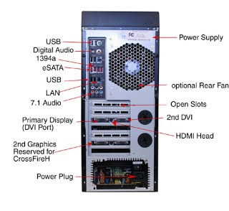
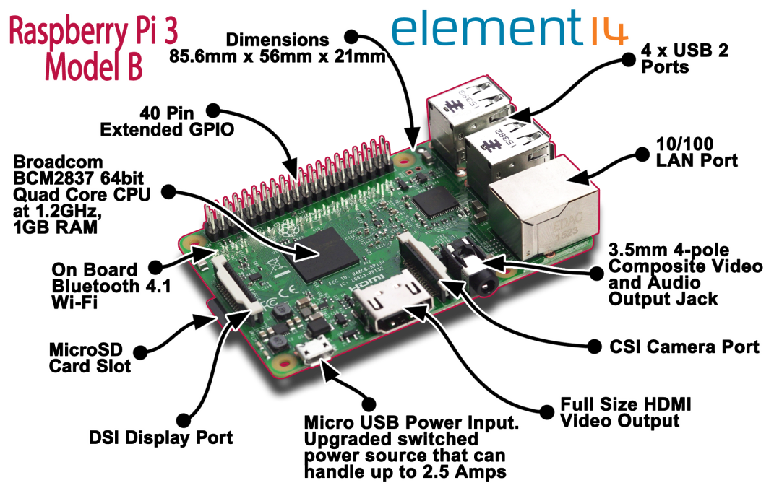
What and Why Raspberry Pi (SBC) ?
Traditional PC | Raspberry PI
Cost: 150 $ - 1000$ | Cost: 5$ to 45 $
Don’t Have onboard GPIO Ports | On Board GPIO Ports
Not Open Source | Open Source / More Control
www.bridgera.com

Slide 4
OS Concept:
Application Space
Application Layer
System Call
Kernel (OS core)
Kernel Space
Hardware Device Driver
GPIO
CPU
Memory
Hardware Space
www.bridgera.com

Slide 5
JavaScript for Hardware
“C’ is not only the programming language to interact with hardware now a days.
Almost all language can interact with system call
JavaScript are C like syntax so easy to remember
JavaScript is widely used in web application, which is much easier to jump to hardware programming
Even You can programme Heavy processor like ARM with JS.
www.bridgera.com

Slide 6
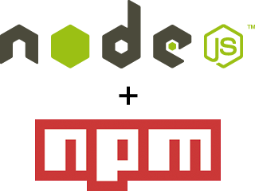
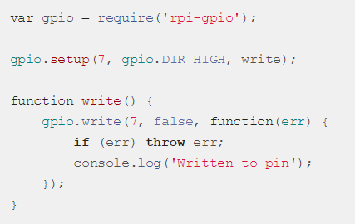
JavaScript - Hello World !!
Fortunately people had already created library for node js to control raspberry pi. https://www.npmjs.com/package/rpi-gpio
www.bridgera.com

Slide 7
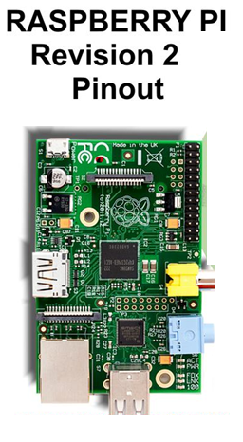
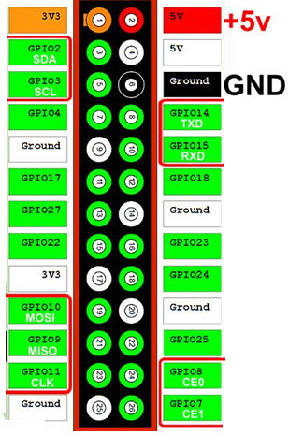
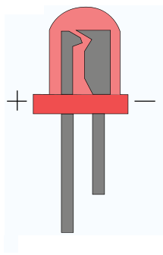
JavaScript - Hello World !!
www.bridgera.com

Slide 8
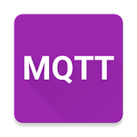
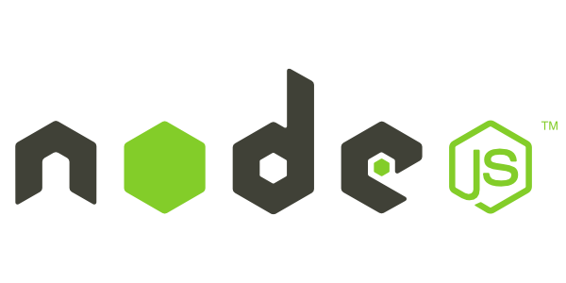
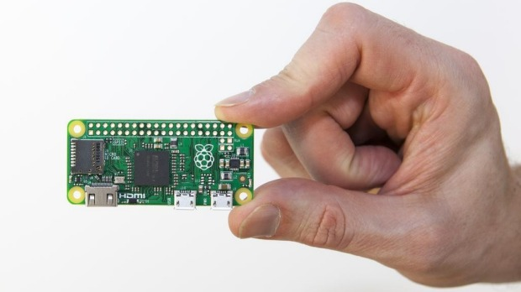
Making Coffee – Combine All
http://brown-bag-demo.16mb.com/
www.bridgera.com

Slide 9
Reference Link:
https://www.espruino.com/ - JavaScript for ESP8266
http://embeddednodejs.com/chapters.html - Node JS for Embedded Hardware
https://www.npmjs.com/package/rpi-gpio - GPIO library for Raspberry PI
https://www.npmjs.com/package/gpio - Another GPIO lib
https://www.npmjs.com/package/mqtt - MQTT library for Node JS
Source Code LINK:
https://github.com/satya-bridgera/brown-bag-19May2017
www.bridgera.com

Slide 10
Thanks !! ☺
www.bridgera.com

